Slide 1
Boycott App
The Palestinian issue & boycott brands

Slide 2
objects
A program to help users determine whether the products they are searching for are boycotted or not.

Slide 3
tools
Illustrator
Visual Studio Code
Git
GitHub

Slide 4
Requirements
create the design by illustrator (background , logo , label , entry , button ).
create the project by Git.
create the window in Visual Studio Code by python programing.
create (background , logo , label , entry , button ) by Visual Studio Code.
connect the project with GitHub.

Slide 5
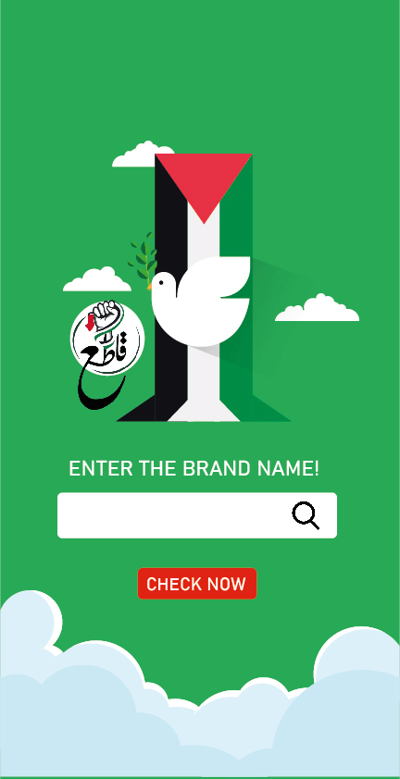
The main page
Create the main page design contains (background, button, label, entry).

Slide 6

First subpage
Create the first subpage design contains (background, label)

Slide 7

Second subpage
Create the second subpage design contains (background, label)

Slide 8
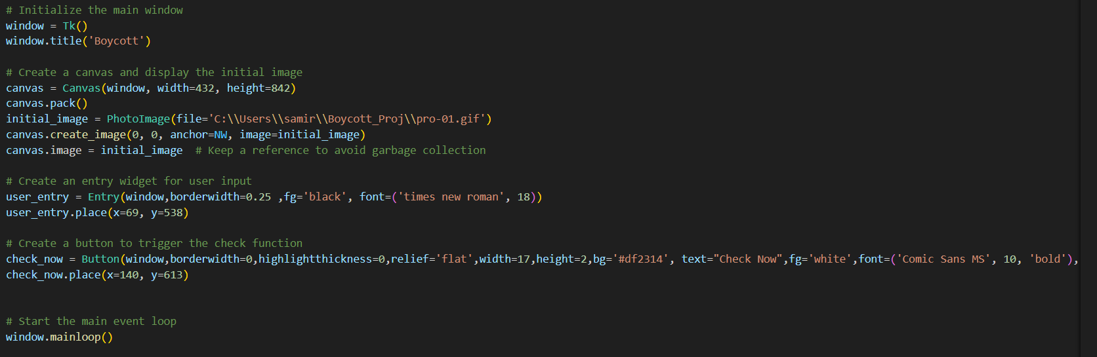
Create python code
Create (window, entry, button).

Slide 9
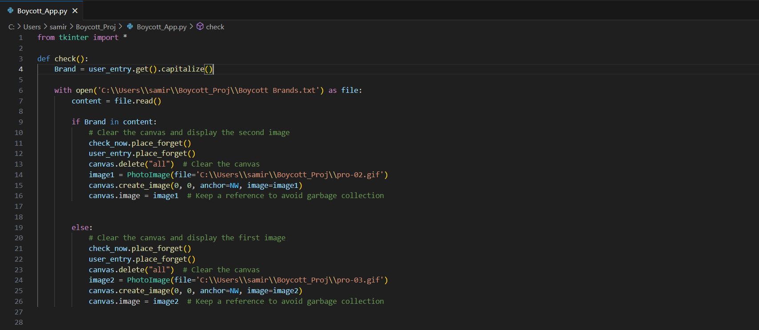
Create a button link to the action

Slide 10
Final result
When the user enters a brand within the boycott,
this his sub-page will appear
visa

Slide 11
Final result
When the user enters a brand that is not within the boycott,
this his sub-page will appear
Frutz

